Slide 1
“If you don’t have time to do it right, when will you have time to do it over?”
- John Wooden

Slide 2
Parts of a Database Design

Slide 3
Database Design
Structures
Rules

Slide 4

Structures
What data will be stored
Where data can be stored to form records
How records will be related to each other to form “truths”
How should records be structured so that redundancies could be minimized
,
Say hi to Table-kun!

Slide 5
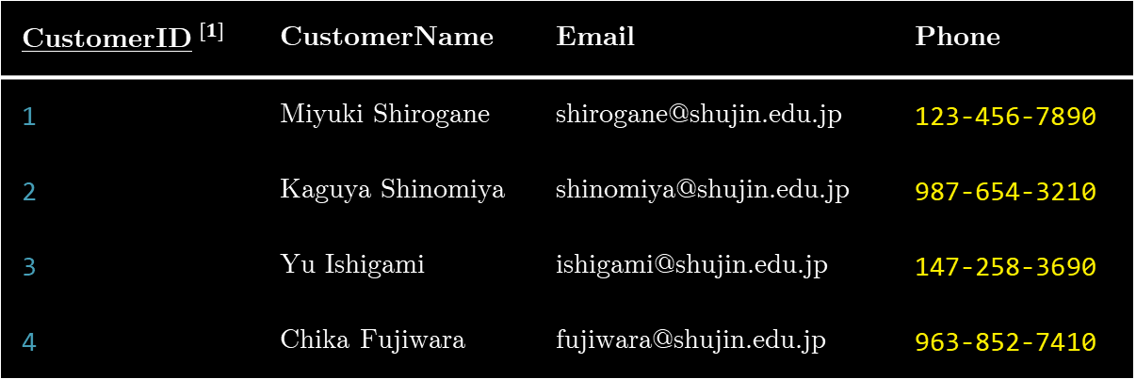
Structures
CustomerID$^{[1]}$ | CustomerName | Email | Phone
1 | Miyuki Shirogane | shirogane@shujin.edu.jp | 123-456-7890
2 | Kaguya Shinomiya | shinomiya@shujin.edu.jp | 987-654-3210
3 | Yu Ishigami | ishigami@shujin.edu.jp | 147-258-3690
4 | Chika Fujiwara | fujiwara@shujin.edu.jp | 963-852-7410
$^{[1]}$ An underscore denotes a primary key

Slide 6
Structures
Tables/Entities
CustomerID$^{[1]}$ | CustomerName | Email | Phone
1 | Miyuki Shirogane | shirogane@shujin.edu.jp | 123-456-7890
2 | Kaguya Shinomiya | shinomiya@shujin.edu.jp | 987-654-3210
3 | Yu Ishigami | ishigami@shujin.edu.jp | 147-258-3690
4 | Chika Fujiwara | fujiwara@shujin.edu.jp | 963-852-7410
$^{[1]}$ An underscore denotes a primary key

Slide 7
Structures
Columns/Fields/Attributes
CustomerID$^{[1]}$ | CustomerName | Email | Phone
1 | Miyuki Shirogane | shirogane@shujin.edu.jp | 123-456-7890
2 | Kaguya Shinomiya | shinomiya@shujin.edu.jp | 987-654-3210
3 | Yu Ishigami | ishigami@shujin.edu.jp | 147-258-3690
4 | Chika Fujiwara | fujiwara@shujin.edu.jp | 963-852-7410
$^{[1]}$ An underscore denotes a primary key

Slide 8
Structures
Primary Key
CustomerID$^{[1]}$ | CustomerName | Email | Phone
1 | Miyuki Shirogane | shirogane@shujin.edu.jp | 123-456-7890
2 | Kaguya Shinomiya | shinomiya@shujin.edu.jp | 987-654-3210
3 | Yu Ishigami | ishigami@shujin.edu.jp | 147-258-3690
4 | Chika Fujiwara | fujiwara@shujin.edu.jp | 963-852-7410
$^{[1]}$ An underscore denotes a primary key

Slide 9
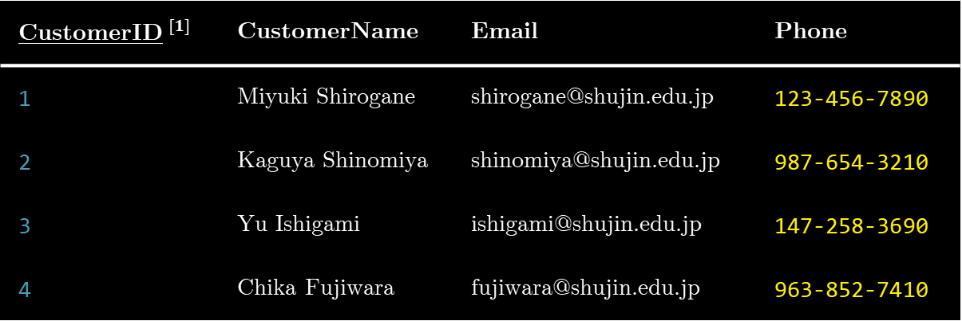
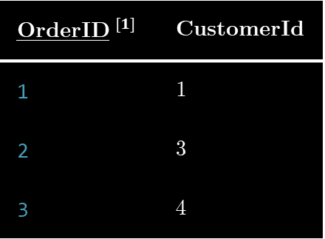
Structures
Primary Key
CustomerID$^{[1]}$ | CustomerName | Email | Phone
1 | Miyuki Shirogane | shirogane@shujin.edu.jp | 123-456-7890
2 | Kaguya Shinomiya | shinomiya@shujin.edu.jp | 987-654-3210
3 | Yu Ishigami | ishigami@shujin.edu.jp | 147-258-3690
4 | Chika Fujiwara | fujiwara@shujin.edu.jp | 963-852-7410
OrderID$^{[1]}$ | CustomerId
1 | 1
2 | 3
3 | 4
$^{[1]}$ An underscore denotes a primary key

Slide 10
Structures
Primary Key
Foreign Key
CustomerID$^{[1]}$ | CustomerName | Email | Phone
1 | Miyuki Shirogane | shirogane@shujin.edu.jp | 123-456-7890
2 | Kaguya Shinomiya | shinomiya@shujin.edu.jp | 987-654-3210
3 | Yu Ishigami | ishigami@shujin.edu.jp | 147-258-3690
4 | Chika Fujiwara | fujiwara@shujin.edu.jp | 963-852-7410
OrderID$^{[1]}$ | CustomerId
1 | 1
2 | 3
3 | 4
$^{[1]}$ An underscore denotes a primary key

Slide 11
Database Design
Structures
Rules

Slide 12
PRIMARY KEY, FOREIGN KEY
NOT NULL, UNIQUE, AUTO-INCREMENT
CASCADE, RESTRICT
Rules
Define how data can be created, stored, and manipulated, ensuring that operations align with organizational policies.

Slide 13
Rules
Integrity of data
Integrity of relationships
Integrity of records
,
A wild Table-kun has appeared!

Slide 14
Rules
Database-oriented
Application-oriented

Slide 15
Database-oriented
Application-oriented
Definition
Enforced directly within the database through constraints, triggers, and stored procedures.
Implemented within the application logic rather than directly in the database.
Example
Column constraints (NOT NULL, UNIQUE, etc.)
Data validation (Widgets, RegEx), Functions/Methods to access data

Slide 16
Database Requirements

Slide 17
Database Requirements
Functional
Non-functional

Slide 18
Functional
Non-functional
Definition
These describe what the database should do for users to accomplish their tasks
These are set of specifications that describe the system's operation capabilities and constraints
Example
Storing customer orders, managing employee records
Using indexing to optimize query performance, designing the database to accommodate scalability, implementing user access control and data encryption for security.

Slide 19
Good Database Design

Slide 20
Good Database Design
Entails all business processes and rules
Data is easily retrieved and modified through an API
Data integrity is ensured
DB Design is transparent to the end user
Data is stored efficiently
Data Integrity
Normalization
Scalability

Slide 21
Data Integrity

Slide 22
CREATE TABLE Orders (
OrderID INT PRIMARY KEY,
ProductID INT,
FOREIGN KEY (ProductID)
REFERENCES Products(ProductID)
ON DELETE CASCADE
);
Data Integrity
The correctness, consistency, and accuracy of data in a database. It ensures that data remains reliable and valid over its lifecycle.

Slide 23
Type | Description
Entity Integrity | Ensures that each row in a table is uniquely identifiable. Achieved by having a primary key for each table, where the key must be unique and not null.
Referential Integrity | Ensures that relationships between tables remain consistent. Enforced using foreign keys, which link a record in one table to a primary key in another table. If a foreign key value is used, it must correspond to an existing primary key value in the related table.
Domain Integrity | Ensures that the values in a column fall within a specified range, type, or set. Enforced using data types, constraints, and validation rules (like CHECK constraints).

Slide 24
Type | Description
Entity Integrity | Ensures that each row in a table is uniquely identifiable. Achieved by having a primary key for each table, where the key must be unique and not null.
Referential Integrity | Ensures that relationships between tables remain consistent. Enforced using foreign keys, which link a record in one table to a primary key in another table. If a foreign key value is used, it must correspond to an existing primary key value in the parent table.
Domain Integrity | Ensures that the values in a column fall within a specified range, type, or set. Enforced using data types, constraints, and validation rules (like CHECK constraints).

Slide 25
Type | Description
Entity Integrity | Ensures that each row in a table is uniquely identifiable. Achieved by having a primary key for each table, where the key must be unique and not null.
OrderID | CustomerName | Product | Quantity | UnitPrice
1001 | Estefanie | Logitech Blue Yeti USB Microphone | 1 | 129.99
1001 | Estefanie | “How to Have the Most Enjoyable Travel” by Adam Gold | 2 | 9.97
1002 | Oliver | “Motivating and Inspiring Students” by Robert J. Marzano | 1 | 27.80
1003 | Marivic | “A Book of Prayers: Grace and Guidance for Your Every Need” by Martin Manser | 1 | 10.99
Does this follow entity integrity? Why or why not?

Slide 26
No! Because the primary key OrderID does not guarantee that each row is uniquely identifiable.
OrderID | CustomerName | Product | Quantity | UnitPrice
1001 | Estefanie | Logitech Blue Yeti USB Microphone | 1 | 129.99
1001 | Estefanie | “How to Have the Most Enjoyable Travel” by Adam Gold | 2 | 9.97
1002 | Oliver | “Motivating and Inspiring Students” by Robert J. Marzano | 1 | 27.80
1003 | Marivic | “A Book of Prayers: Grace and Guidance for Your Every Need” by Martin Manser | 1 | 10.99

Slide 27
Type | Description
Entity Integrity | Ensures that each row in a table is uniquely identifiable. Achieved by having a primary key for each table, where the key must be unique and not null.
Referential Integrity | Ensures that relationships between tables remain consistent. Enforced using foreign keys, which link a record in one table to a primary key in another table. If a foreign key value is used, it must correspond to an existing primary key value in the related table.
Domain Integrity | Ensures that the values in a column fall within a specified range, type, or set. Enforced using data types, constraints, and validation rules (like CHECK constraints).

Slide 28
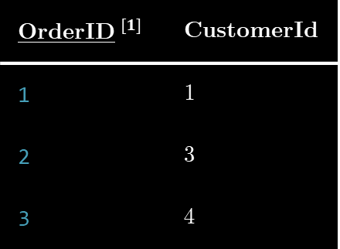
Type | Description
Referential Integrity | Ensures that relationships between tables remain consistent. Enforced using foreign keys, which link a record in one table to a primary key in another table. If a foreign key value is used, it must correspond to an existing primary key value in the related table.
Primary Key
Foreign Key
CustomerID | CustomerName | Email | Phone
1 | Miyuki Shirogane | shirogane@shujin.edu.jp | 123-456-7890
2 | Kaguya Shinomiya | shinomiya@shujin.edu.jp | 987-654-3210
3 | Yu Ishigami | ishigami@shujin.edu.jp | 147-258-3690
4 | Chika Fujiwara | fujiwara@shujin.edu.jp | 963-852-7410
OrderID$^{[1]}$ | CustomerId
1 | 1
2 | 3
3 | 4
Does this follow referential integrity? Why or why not?

Slide 29
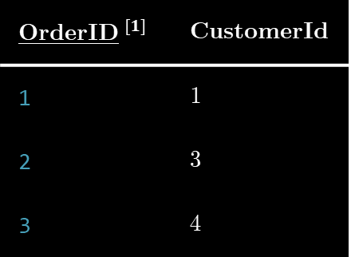
Type | Description
Referential Integrity | Ensures that relationships between tables remain consistent. Enforced using foreign keys, which link a record in one table to a primary key in another table. If a foreign key value is used, it must correspond to an existing primary key value in the related table.
Primary Key
Foreign Key
CustomerID | CustomerName | Email | Phone
1 | Miyuki Shirogane | shirogane@shujin.edu.jp | 123-456-7890
2 | Kaguya Shinomiya | shinomiya@shujin.edu.jp | 987-654-3210
3 | Yu Ishigami | ishigami@shujin.edu.jp | 147-258-3690
OrderID$^{[1]}$ | CustomerId
1 | 1
2 | 3
3 | 4
Does this follow referential integrity? Why or why not?

Slide 30
No! Because the FK CustomerID does not correspond to an existing PK in the parent table.
Primary Key
Foreign Key
CustomerID | CustomerName | Email | Phone
1 | Miyuki Shirogane | shirogane@shujin.edu.jp | 123-456-7890
2 | Kaguya Shinomiya | shinomiya@shujin.edu.jp | 987-654-3210
3 | Yu Ishigami | ishigami@shujin.edu.jp | 147-258-3690
OrderID$^{[1]}$ | CustomerId
1 | 1
2 | 3
3 | 4
?

Slide 31
Type | Description
Entity Integrity | Ensures that each row in a table is uniquely identifiable. Achieved by having a primary key for each table, where the key must be unique and not null.
Referential Integrity | Ensures that relationships between tables remain consistent. Enforced using foreign keys, which link a record in one table to a primary key in another table. If a foreign key value is used, it must correspond to an existing primary key value in the related table.
Domain Integrity | Ensures that the values in a column fall within a specified range, type, or set. Enforced using data types, constraints, and validation rules (like CHECK constraints).

Slide 32
Type | Description
Domain Integrity | Ensures that the values in a column fall within a specified range, type, or set. Enforced using data types, constraints, and validation rules (like CHECK constraints).
UserID | UserName | Age | Phone | Email
1 | Miyuki Shirogane | 18 | 123-456-7890 | shirogane@shujin.edu.jp
2 | Kaguya Shinomiya | 18 | 911 | shinomiya@shujin.edu.jp
3 | Yu Ishigami | 16 | 147-258-3690 | ishigami
4 | Chika Fujiwara | -1 | 963-852-7410 | fujiwara@shujin.edu.jp
Does this follow domain integrity? Why or why not?

Slide 33
No! Because there are domain violations
in multiple columns.
UserID | UserName | Age | Phone | Email
1 | Miyuki Shirogane | 18 | 123-456-7890 | shirogane@shujin.edu.jp
2 | Kaguya Shinomiya | 18 | 911 | shinomiya@shujin.edu.jp
3 | Yu Ishigami | 16 | 147-258-3690 | ishigami
4 | Chika Fujiwara | -1 | 963-852-7410 | fujiwara@shujin.edu.jp
Does this follow domain integrity? Why or why not?

Slide 34
Color Scheme
Computer Modern Serif
Consolas

